Slide 1
1/22 Sprint Presentation
“Capstone Defense”

Slide 2
User Stories (Sprint 1)
As a user, I want to create a new user account for the game.
As a user, I want to set up/change the password for my user account.
As a user, I want a way to verify my email address.
As a user, I want to log into my account using the website.
As a developer, I want to lock user accounts if they are trying to be compromised.

Slide 3
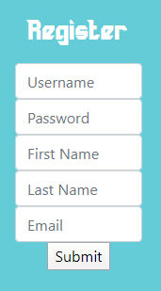
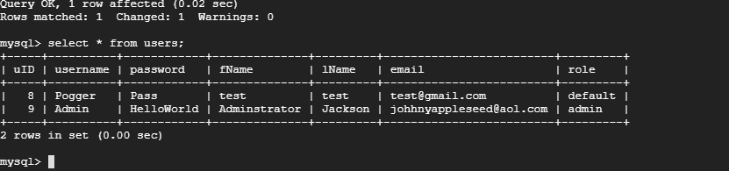
User Account Creation
A user is able to register an account
The user is sent an email verification to activate account*
On creation, an account will be ‘locked’ then set to ‘default’ once email is verified
PHP to SQL
Notes:
So heres the dealio, the mail exchange server isn’t up and running but this sort of the jist of how it would work. Also passwords will need to be hashed

Slide 4
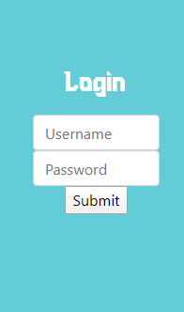
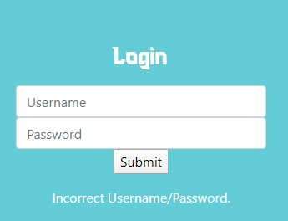
Login
After User creation and verification, a user is able to log in and a session is started
Failure to verify, outputs ‘please verify email’
Mismatch username or password yields ‘Incorrect Username/Password’

Slide 5
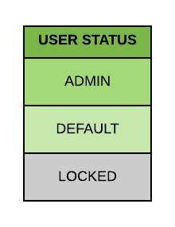
Role Management
Role: Admin
Rights:
Lock and unlock accounts
Same rights as Default
Role: Default
Rights:
Update Profile
Update password for account
View highscores

Slide 6
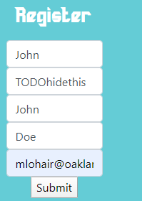
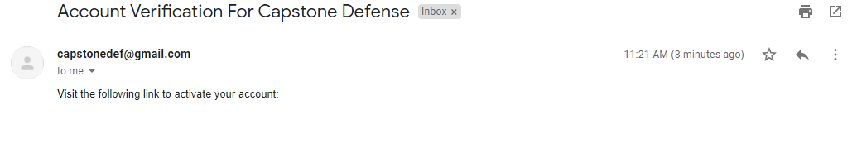
Email Verification

Slide 7
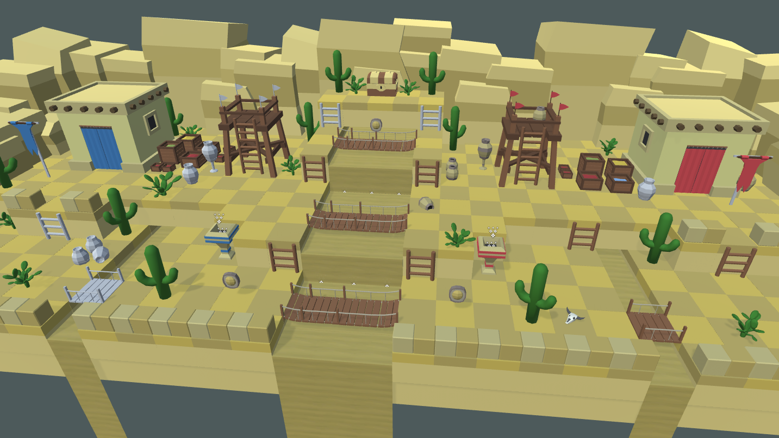
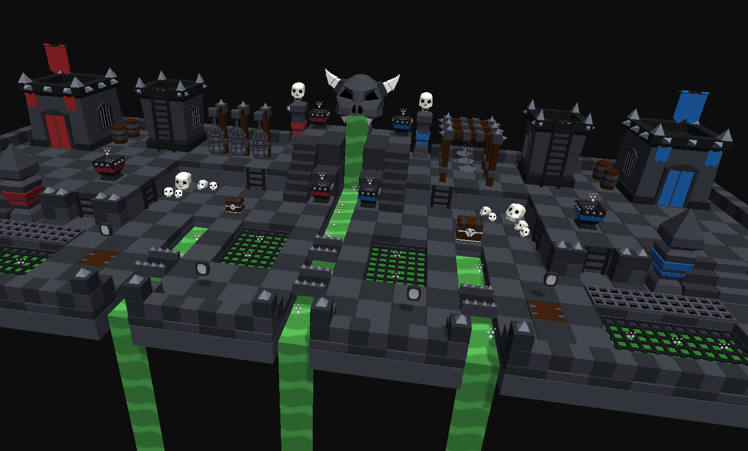
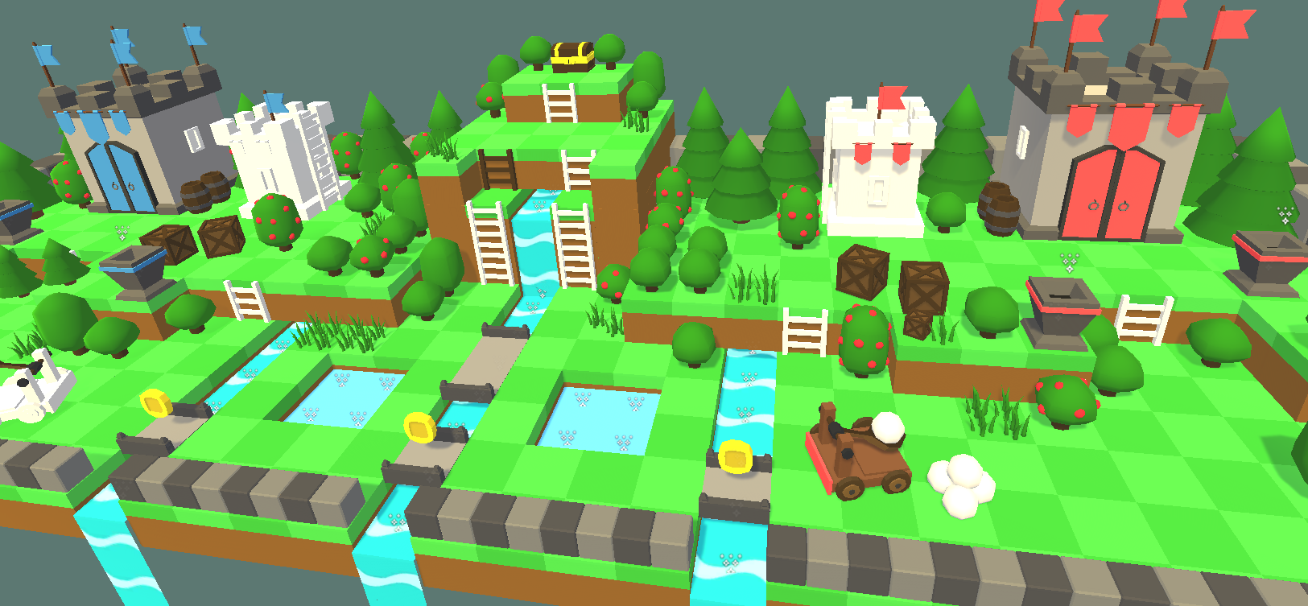
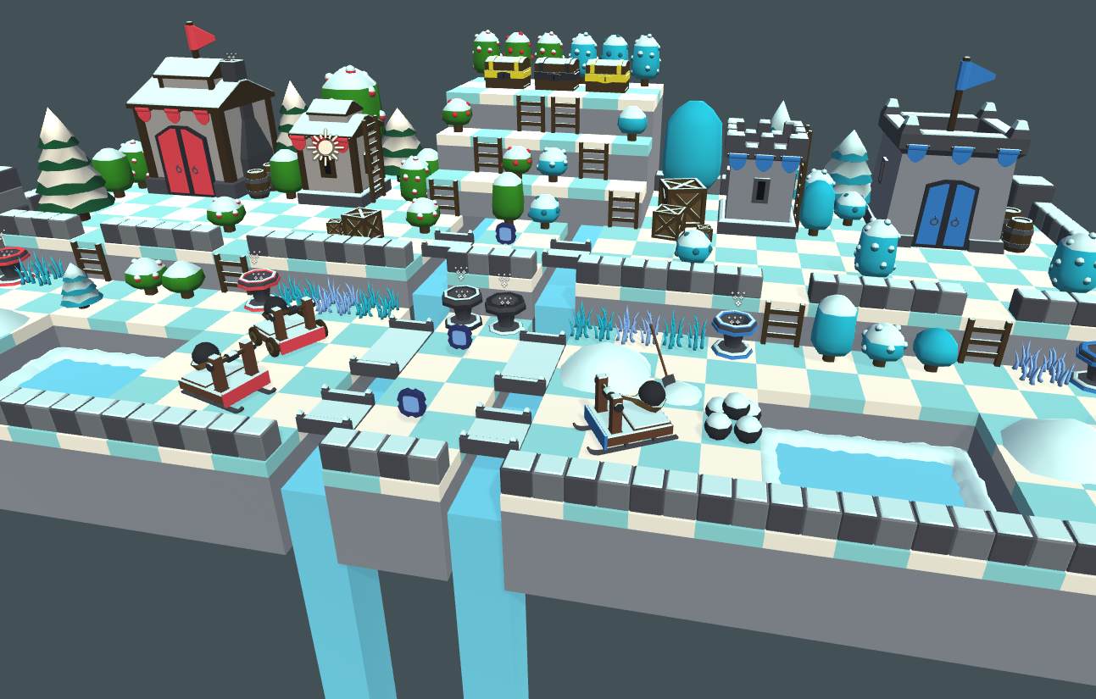
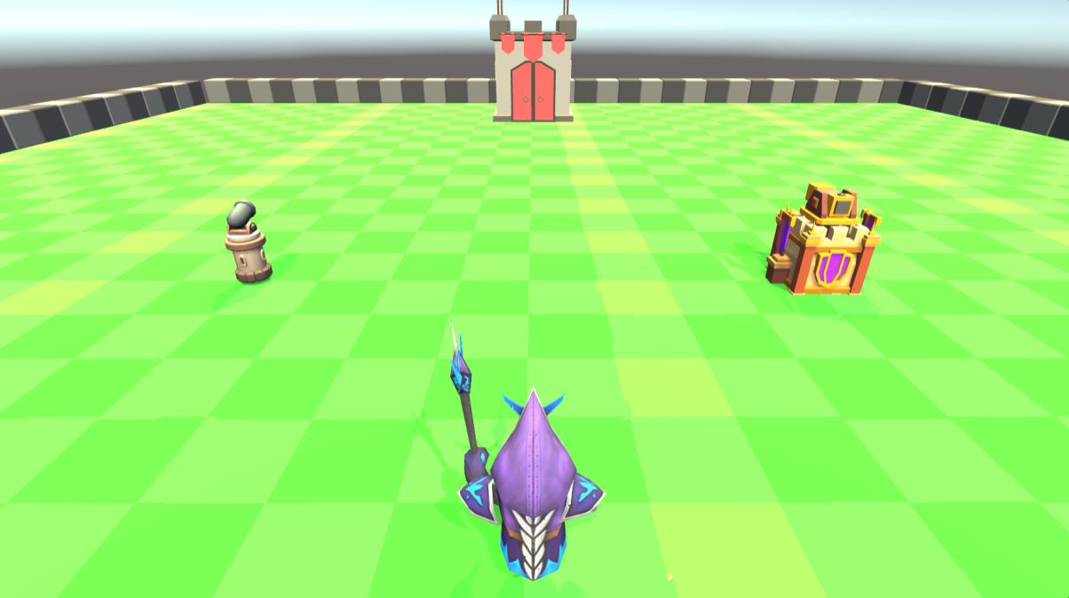
UI/UX

Slide 8
QA Tests
Testing website functionality:
o Website on following platforms:
Windows
· Chrome – Fully functional
· Firefox – Fully functional
· Microsoft Edge – Fully functional
Mac
· Safari – Fully functional
· Chrome – Fully functional
· Firefox – Fully functional
Android
· Chrome – Top navbar does not show up properly otherwise functional
· Samsung Internet app – Top navbar does not show up properly otherwise functional
IOS
· Chrome – Top navbar does not show up properly otherwise functional
· Safari – Top navbar does not show up properly otherwise functional

Slide 9
QA Tests
Testing user account creation:
o Desktop Web Browsers
User account creations are successful
User log in is successful
o Mobile Web Browsers
User account creations are successful
User log in is successful

Slide 10
User stories to be completed in next sprint
As a user, I want to check my personal high score in the game.
As a user, I want to be able to view the leaderboard for all the high scores that exist.
As a user, I want to change the username affiliated with my user account.
As a user, I want to be able to unlock my account if it was locked for security reasons.

Slide 11
UI/UX for the next sprint
Implementation of proper interfaces for the game
Health Bar
Faded Movement Controls
Optional Buttons
Overhaul of the website to increase readability and usability
Pages
Profiles
Landing page
Placeholder for leaderboards
Information about the game
Possibly a link to a wiki on the game or helpful information on the game

Slide 12
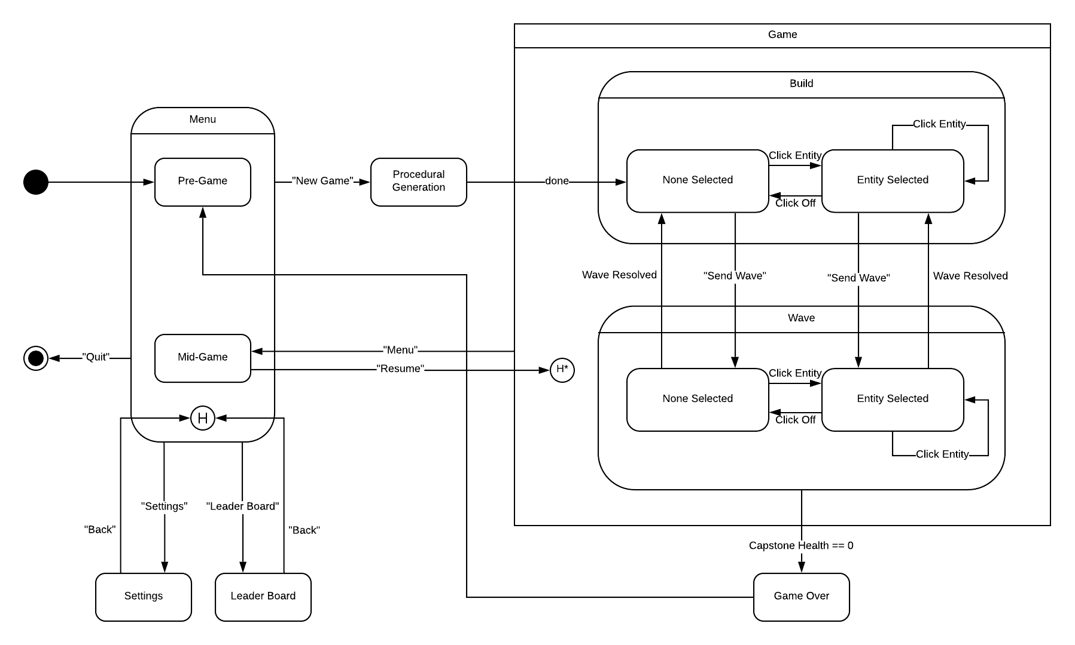

Slide 13
Demo

